Slide 1

Geometry
Unit 6, Lesson H3 Justifying Similarity Volume 1, pg. 343

Slide 2


Benchmark
MA.912.GR.2.9
Justify the criteria for triangle similarity using the definition of similarity in terms of non-rigid transformations.
volume 1, pg. 343

Slide 3
Integrated Mathematical Thinking and Reasoning Standards
MA.K12.MTR.1.1 Actively participate in effortful learning both individually and collectively.
MA.K12.MTR.2.1 Demonstrate understanding by representing problems in multiple ways.
MA.K12.MTR.4.1 Engage in discussions that reflect on the mathematical thinking of self and others.
MA.K12.MTR.5.1 Use patterns and structure to help understand and connect mathematical concepts.
MA.K12.MTR.6.1 Assess the reasonableness of solutions.
volume 1, pg. 343

Slide 4

Learning Target
I can use the definition of similarity to justify that SSS similarity, SAS similarity, and AA similarity are sufficient to show that two triangles are similar.
volume 1, pg. 343

Slide 5

Warm-Up
volume 1, pg. 343

Slide 6
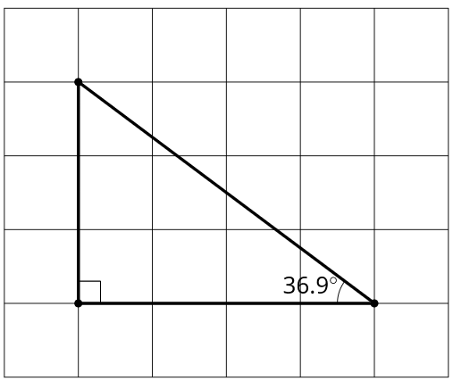
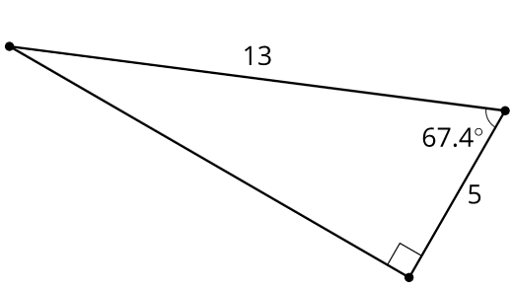
6.H3.1 Warm-Up: Which One Doesn’t Belong?
Image A | Image B
Choose an image that does not belong and explain your choice.
volume 1, pg. 343

Slide 7
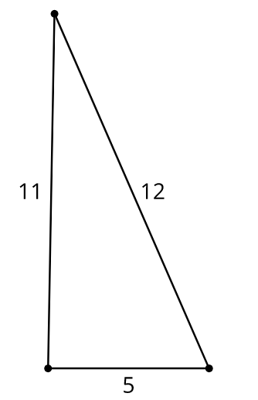
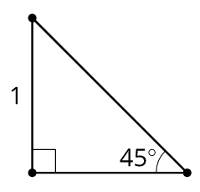
Image C | Image D
volume 1, pg. 343

Slide 8

Collaboration
volume 1, pg. 344

Slide 9

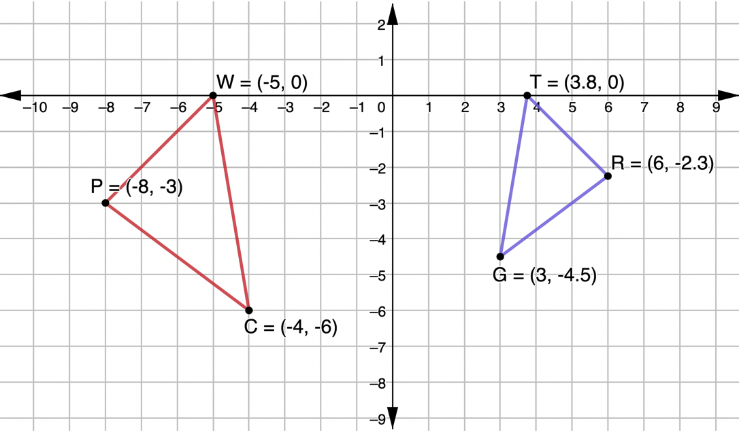
6.H3.2 Collaboration: Justifying Similarity
$∆PWC$ and $∆RTG$ are shown.
volume 1, pg. 344

Slide 10
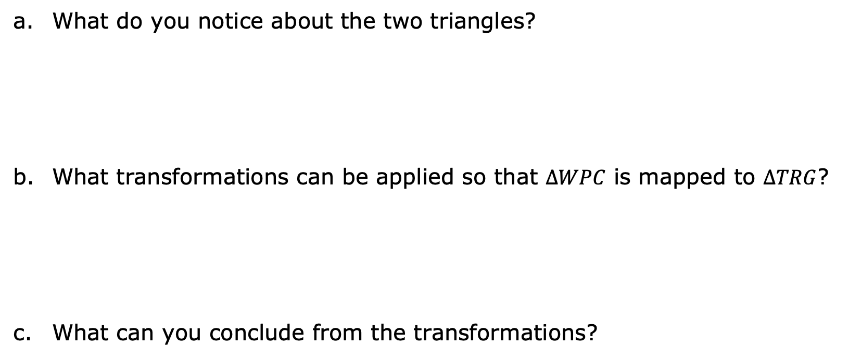
What do you notice about the two triangles?
What transformations can be applied so that $∆WPC$ is mapped to $∆TRG$?
What can you conclude from the transformations?
volume 1, pg. 344

Slide 11
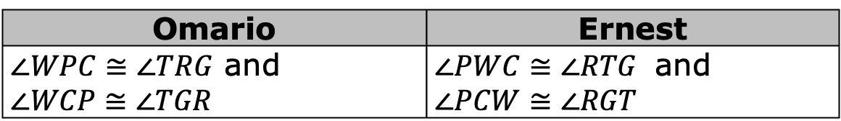
Omario’s and Ernest’s answers to the question “If $∆PWC$ and $∆RTG$ are similar by angle-angle similarity, what information would need to be given?” are shown.
Omario | Ernest
$∠WPC≅∠TRG$ and $∠WCP≅∠TGR$ | $∠PWC≅∠RTG$ and $∠PCW≅∠RGT$
What do you notice about their answers?
Explain why both students correctly answered the question.
volume 1, pg. 344

Slide 12
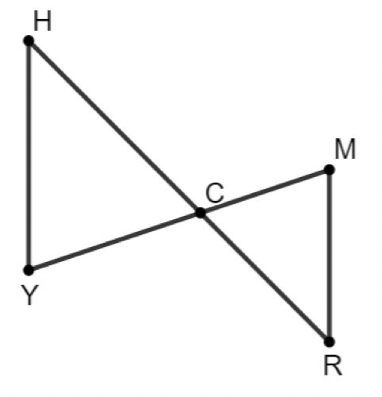
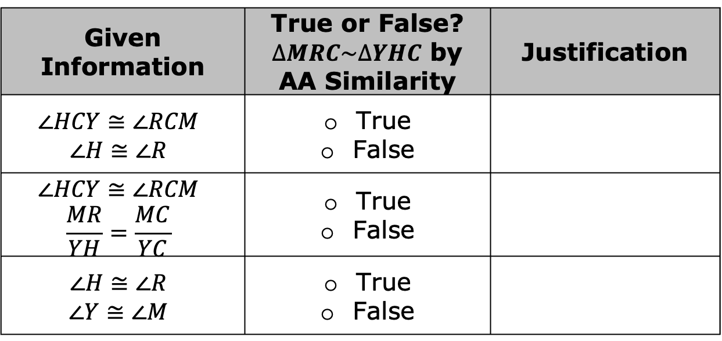
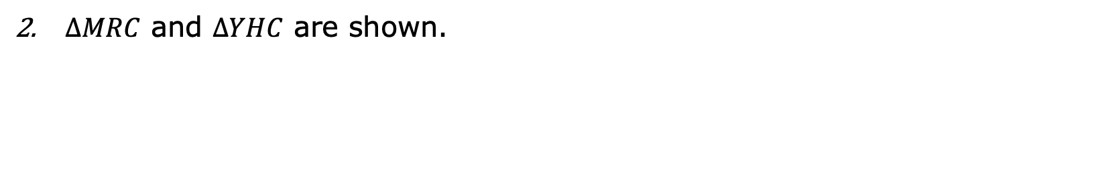
$∆MRC$ and $∆YHC$ are shown.
Complete the table.
Given Information | True or False? $∆MRC\sim ∆YHC$ by AA Similarity | Justification
$$∠HCY≅∠RCM$$ $$∠H≅∠R$$ | True False
$$∠HCY≅∠RCM$$ $$\frac{MR}{YH}=\frac{MC}{YC}$$ | True False
$$∠H≅∠R$$ $$∠Y≅∠M$$ | True False
volume 1, pg. 345

Slide 13
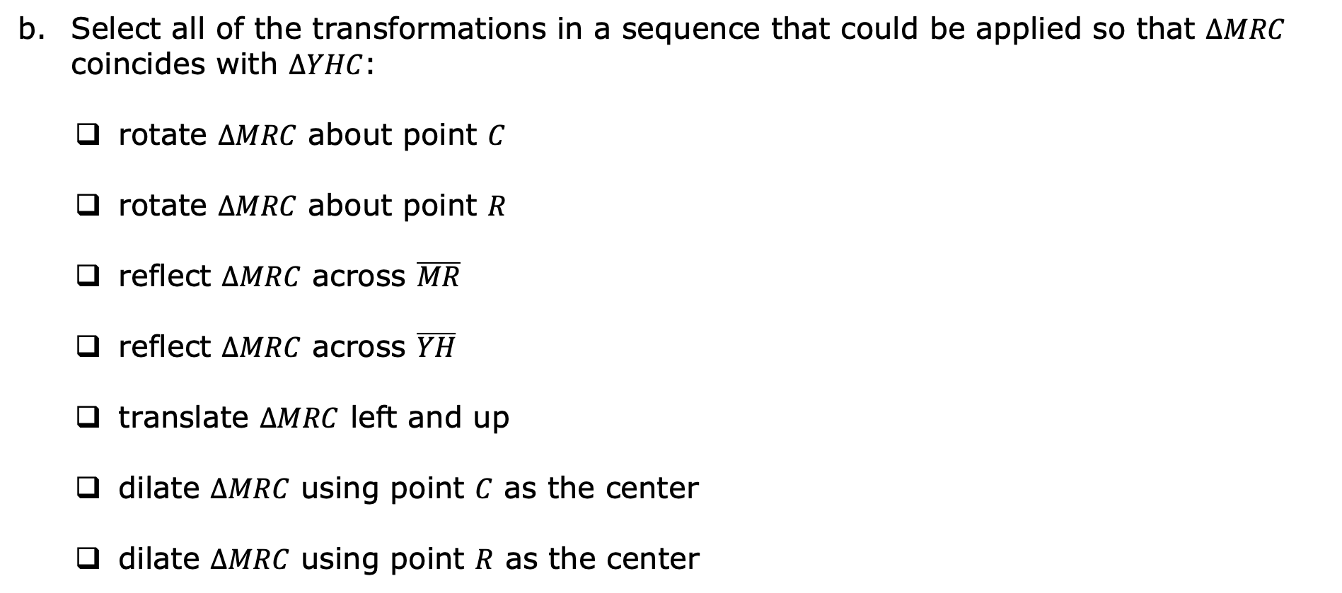
Select all of the transformations in a sequence that could be applied so that $∆MRC$ coincides with $∆YHC$:
rotate $∆MRC$ about point $C$
rotate $∆MRC$ about point $R$
reflect $∆MRC$ across $\overline{MR}$
reflect $∆MRC$ across $\overline{YH}$
translate $∆MRC$ left and up
dilate $∆MRC$ using point $C$ as the center
dilate $∆MRC$ using point $R$ as the center
volume 1, pg. 345

Slide 14



Discuss with your partner what is true about the triangles when all of the transformations have been applied.
Similarity in terms of non-rigid transformations is one or more rigid transformations (reflection, rotation, translation) combined with a dilation that leads to two figures being similar.
Similarity is having exactly the same shape but not necessarily the same size. Two figures are similar if and only if one figure can be obtained from the other by a dilation, or a sequence of transformations that includes a dilation.
volume 1, pg. 345

Slide 15
Use the definition of similarity in terms of non-rigid motions to justify that $∆MRC$ and $∆YHC$ are similar.
volume 1, pg. 345

Slide 16
Consider the following statement.
If it is possible to find one or more transformations that will transform a figure such that all corresponding points coincide with the other figure, then the figures will be similar.
Explain what this statement means in your own words.
volume 1, pg. 346

Slide 17
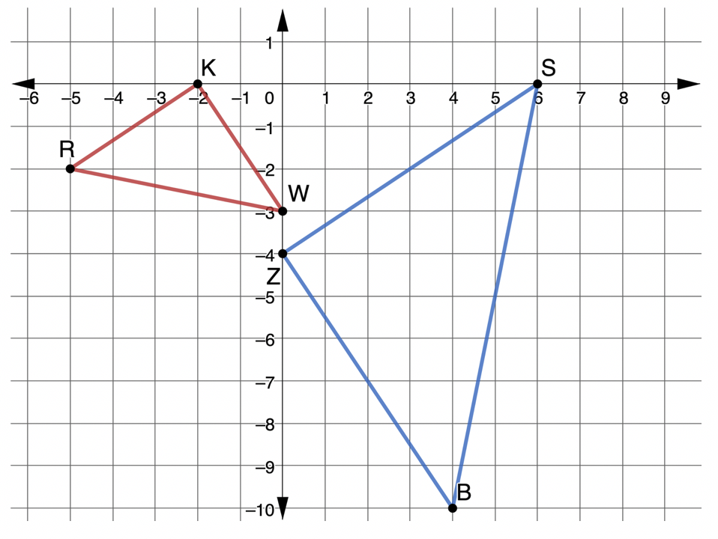
$∆RKW$ and $∆BZS$ are shown.
Assume: $\frac{RW}{BS}=\frac{WK}{SZ}=\frac{KR}{ZB}$
Explain how you can use patty paper to verify $∆RKW\sim ∆BZS$.
volume 1, pg. 346

Slide 18
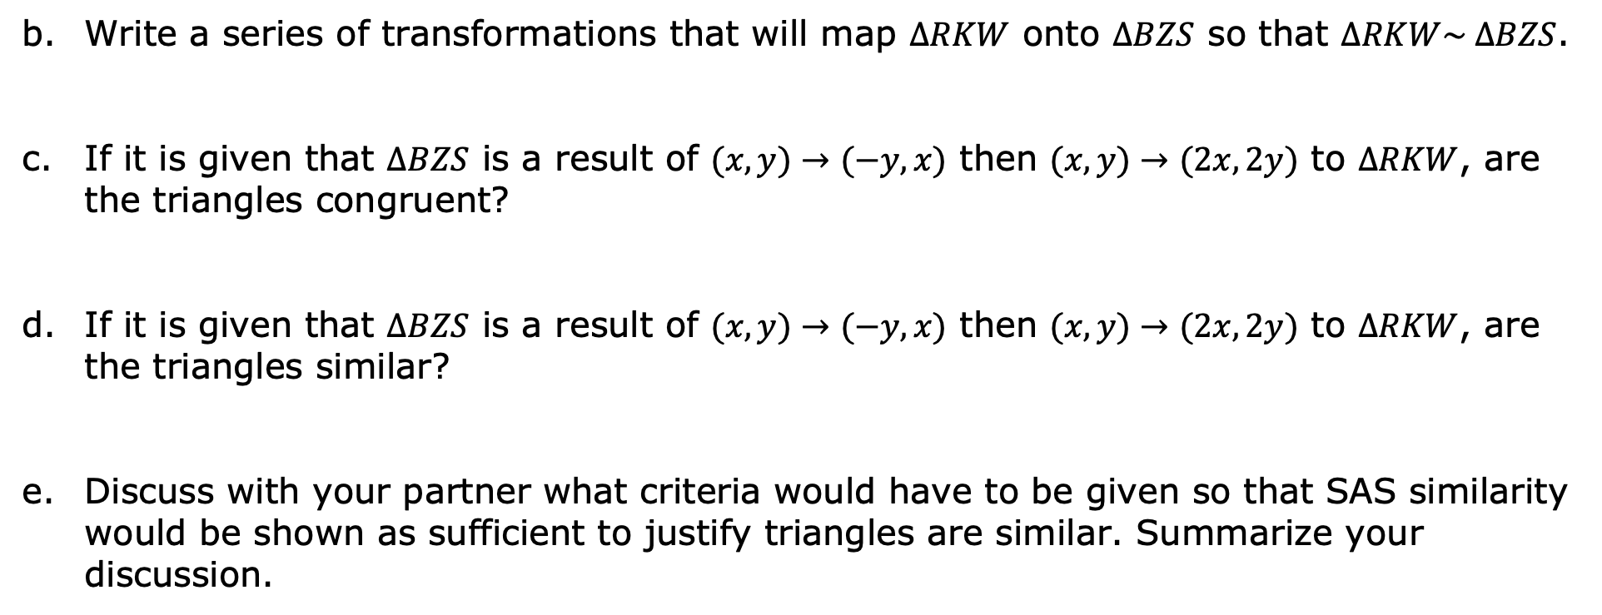
Write a series of transformations that will map $∆RKW$ onto $∆BZS$ so that $∆RKW\sim ∆BZS$.
If it is given that $∆BZS$ is a result of $(x,y)→(−y,x)$ then $(x,y)→(2x,2y)$ to $∆RKW$, are the triangles congruent?
If it is given that $∆BZS$ is a result of $(x,y)→(−y,x)$ then $(x,y)→(2x,2y)$ to $∆RKW$, are the triangles similar?
Discuss with your partner what criteria would have to be given so that SAS similarity would be shown as sufficient to justify triangles are similar. Summarize your discussion.
volume 1, pg. 346

Slide 19
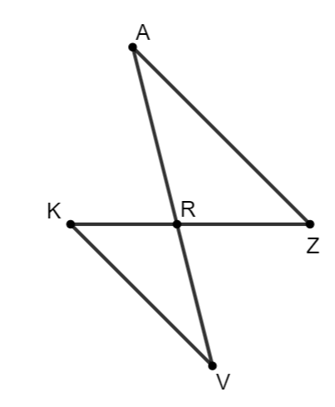
Katelyn, Diego, and Amelia are writing conclusions about proving similarity in triangles. They used $∆KRV$ and $∆ZRA$ to write their conclusions. Their conclusions are shown.
Assume: $∠VKR≅∠AZR$ and $∠VRK≅∠ARZ$
volume 1, pg. 347

Slide 20
Katelyn’s Conclusion | Diego’s Conclusion | Amelia’s Conclusion
To prove similarity of two triangles, apply the definition of congruence in terms of rigid motions to show that two angles that are assumed to be congruent are congruent. This is sufficient to prove similarity of two triangles. | Show that two triangles are congruent using rigid motions and dilation. Then, apply the definition of similarity in terms of non-rigid transformations. This is sufficient to prove the triangles are similar. | By applying a series of rigid transformations and a dilation, it could be shown that the triangles are similar by showing that one set of sides are proportional and assumed two angles are congruent.
Whose conclusion do you agree with?
volume 1, pg. 347

Slide 21
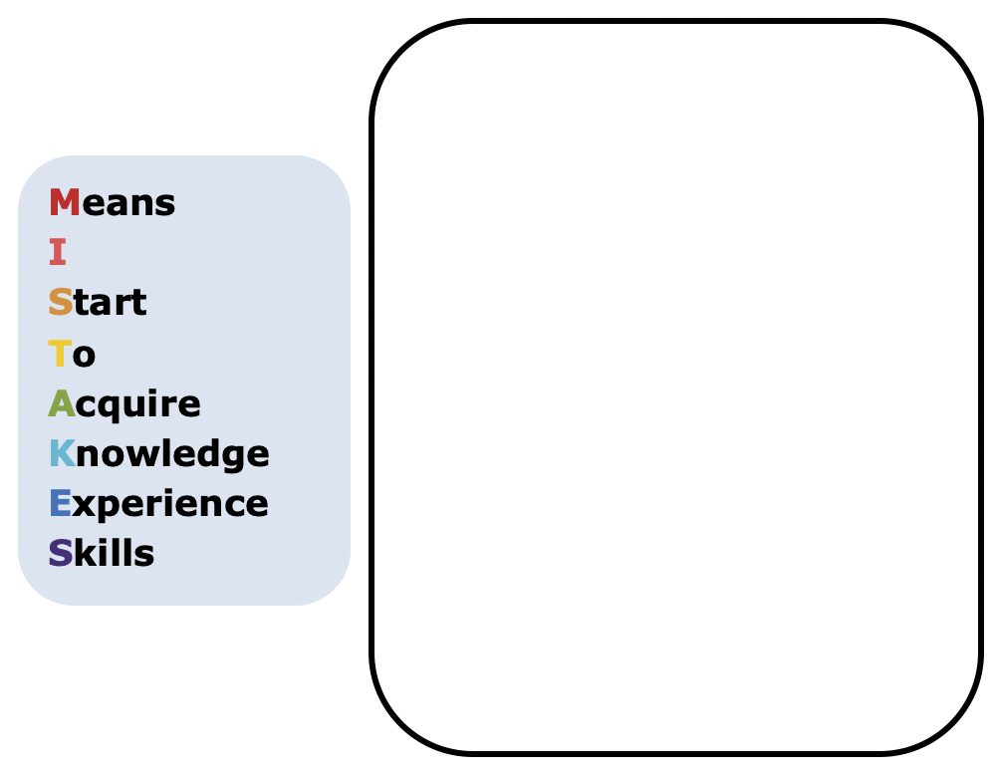
Explain why you agree with that student.
Pick one student whose conclusion is incorrect. Write a note to them to help them understand their error.
volume 1, pg. 347

Slide 22

Wrap-Up
volume 1, pg. 348

Slide 23
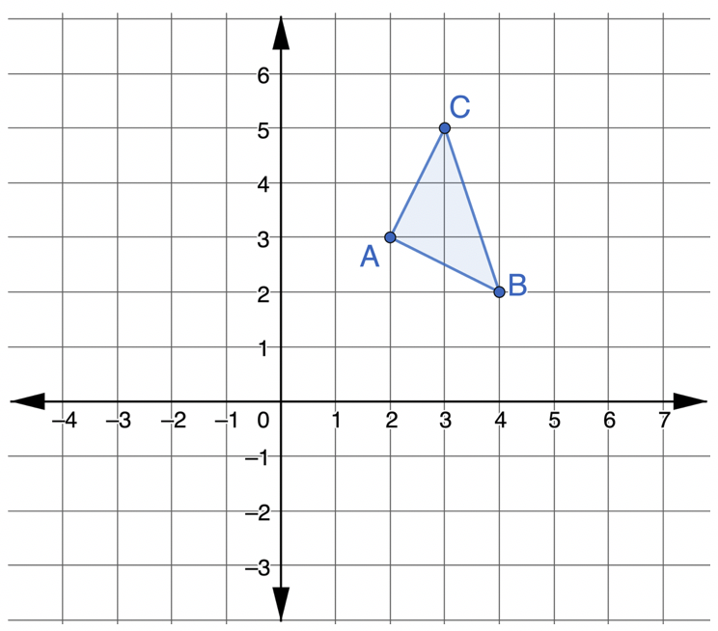
6.H3.3 Wrap-Up: Cool Down
$∆ABC$ is shown.
volume 1, pg. 348

Slide 24
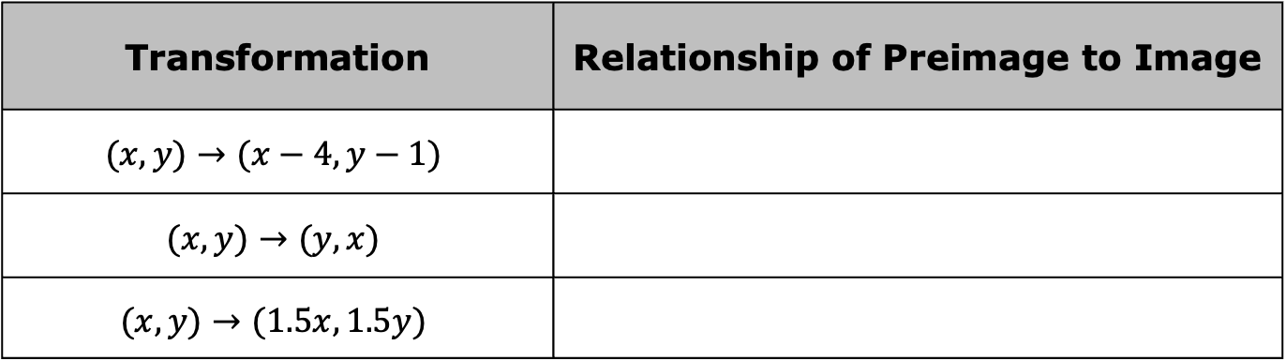
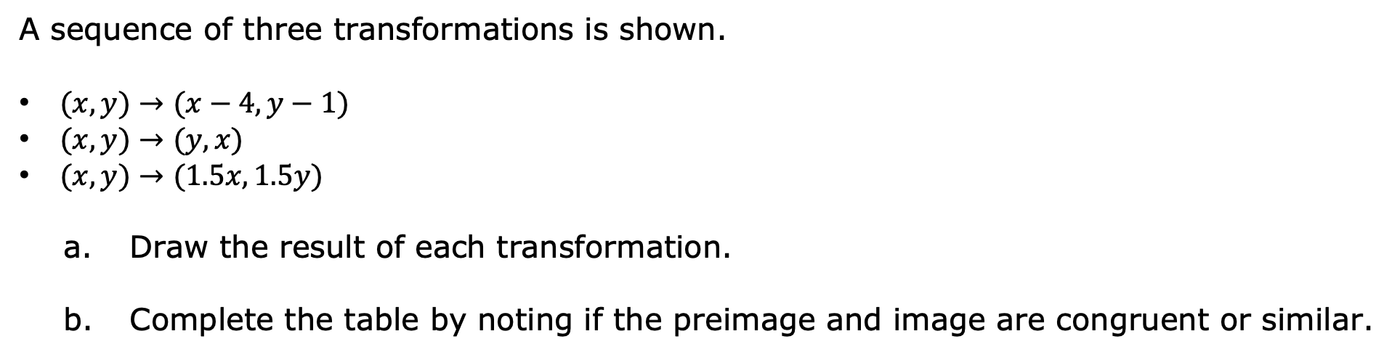
A sequence of three transformations is shown.
$(x,y)→(x−4,y−1)$
$(x,y)→(y,x)$
$(x,y)→(1.5x,1.5y)$
Draw the result of each transformation.
Complete the table by noting if the preimage and image are congruent or similar.
Transformation | Relationship of Preimage to Image
$$(x,y)→(x−4,y−1)$$
$$(x,y)→(y,x)$$
$$(x,y)→(1.5x,1.5y)$$
volume 1, pg. 348

